Slide 1



Job Vacancy Management System
Challenge 9
Overview and Key Features
Iván Núñez Rodríguez – Backend Developer
David Fernández Fernández – Frontend Developer (Android)
Andrés Felipe González Gómez – Frontend Developer (JavaFX)
Ángel Antón Gaitán – Documentation, presentation and Business Analysis (EIE)
2º CFGS DAM

Slide 2




Proyect overview
1.
System Purpose: Streamline job recruitment processes.
Target Audience: Companies and job seekers.
Key features:
Vacancy posting and management.
Job searching and filtering.
Application tracking and management.

Slide 3



Backend Development
2.
API Architecture: RESTful API
Technologies: Spring Boot, MySQL 8
Some Key Endpoints:
/vacantes: View all vacancies
/auth/login: Login & Token generation
/solicitudes: Submit a job application

Slide 4
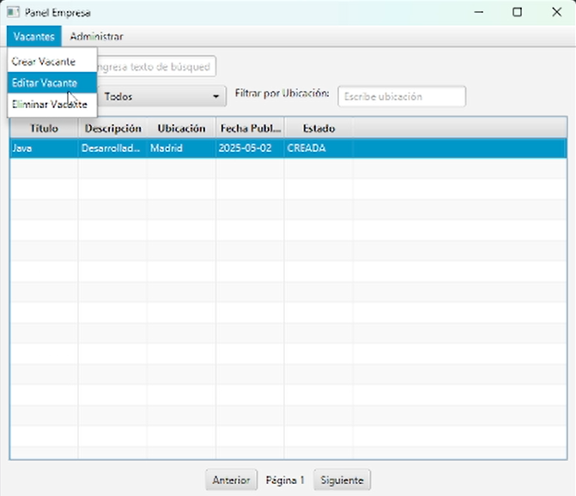
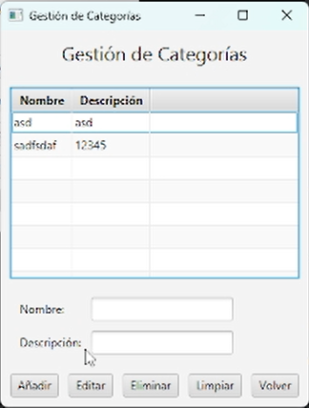
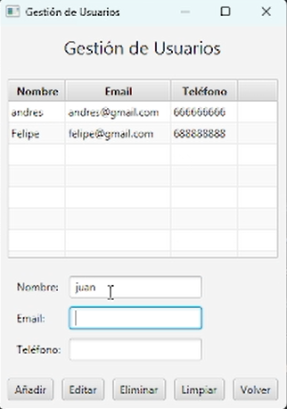
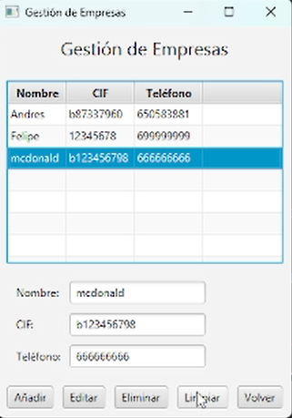
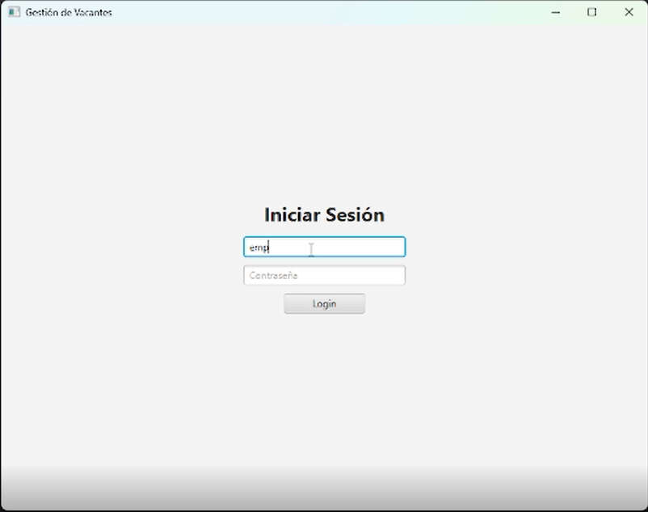
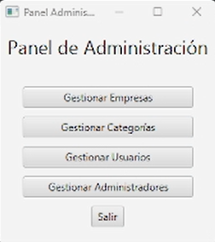
Frontend Development (JavaFX)
3.
Company Features
Vacancy Management
Application review
Admin Features
User management
Company Management
Category Management

Slide 5

Frontend Development (Android)
4.
User Features
Job searching and filtering
Application submission
Application tracking

Slide 6
Deployment and Configuration
5.
Configuration: Database, API endpoints
Security: API security, and User data security
Backend Deployment: Spring Boot JAR
JavaFX Deployment: Executable JAR
Android Deployment: Android Emulator

Slide 7
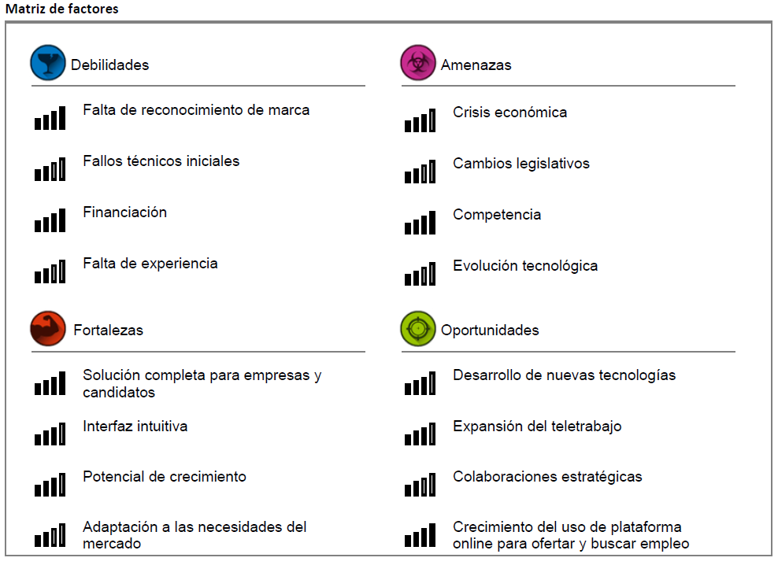
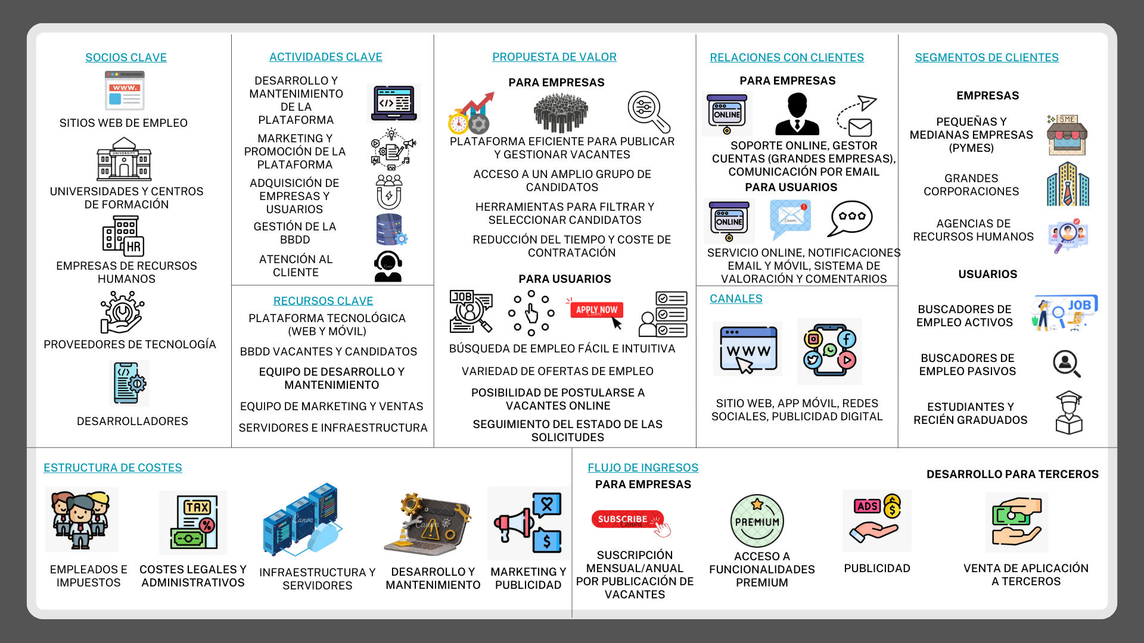
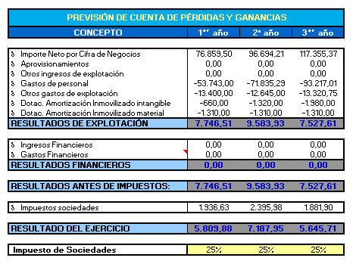
Business Analysis
6.
Model business canvas
SWOT analysis: strengths, weaknesses, opportunities and threats
Target Audience and competitive analysis
Market trends and Market analysis
Financial analysis

Slide 8

Conclusion
7.
Project Achievements
Limitations
Future Enhancements

